Slide 1
How do Poor People Survive?
Exploring another facet
of the “wealth-in-people” concept
Notes:
What does “wealth-in-people” mean?

Slide 2
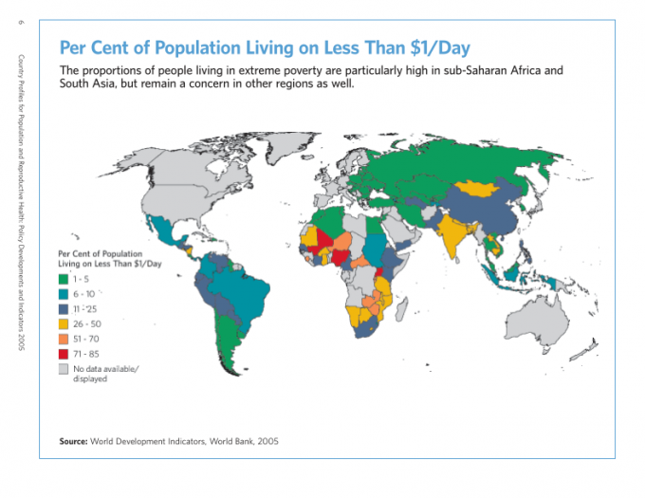
Notes:
Look at the yellow, pink, and red
What is the percentage of Ethiopia’s population living under a dollar a day?

Slide 3
How do People Survive on Less than $1/day?
Notes:
Reciprocity
Not all resources commodified: land
Cost of living is cheaper
The statistics may not be true: people may be getting income that is not reported. 18% unemployment rate in Ethiopia: is that true?

Slide 4
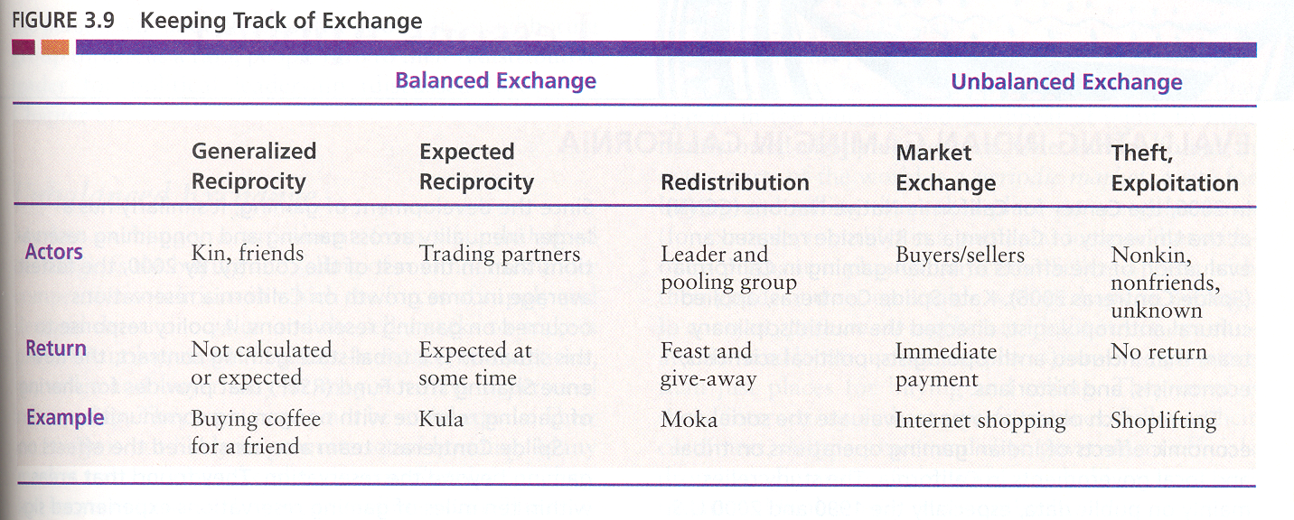
Notes:
This chart represents different kinds of exchanges among people more closely to more distantly related.
Generalized reciprocity encompasses exchanges in which the value of what is exchange is not carefully calculated and the timing and amount of repayment are not predetermined. For us, it is common among close kin or close friends, serving as an expression of personal connection while reinforcing family and social networks. You might borrow a pen or piece of paper from a classmate, you might offer some of your food to a friend. Parents provide for their children---food, shelter, education, clothes, protection—without calculating the value or expecting repayment.
Expected reciprocity occurs between people more distantly connected. The recipient of a gift has the obligation to accept the gift and to reciprocate promptly with a gift of equal value. The goal of exchange is to build and maintain social relationships, beyond the immediate kin group.
Redistribution: goods collected from the members of a group and reallocated in different ways. Redistribution requires the collected goods to flow through a central location---a chief, a storehouse, or a central government, where it can be stored, counted, and redistributed. In small-scale societies, redistribution brings prestige to the community leader as food and goods collected from the leader’s supporters are reallocated for supporting the general population or establishing alliances with outside groups. Taxes are a common system of redistribution in our society.
Market economy: exchange in which there is immediate payment. Does not hinge on cash; could hinge on credit, p. 327
Negative reciprocity: theft and exploitation
Note: these co-exist in our society

Slide 5
What are the implications of reciprocity for those who earn more than others?
Notes:
Does this work in reducing social and economic inequality?

Slide 6
What is the “dark side” of reciprocity?
Notes:
Connect back to witchcraft

Slide 7
How do the wealthy limit demands on them in Jimma? Similar to Abidjan?
Notes:
Significance of religious conversion (Christianity) in allowing people to save
Link to Eugen Weber

Slide 8
Informal Urban Economy
Work that does not follow state regulations (re: wages, overtime, safety, taxes, licenses, etc). Illegal, but not criminal. In the United States, “under the table”
This share of the economy has been growing recently in the US: subcontracting, offshoring; example of Eric Garner in NYC
What are some features of the informal economy in Ethiopia?
Notes:
Needs trust and loyalty
Gifts in lieu of payment
Zemed
Patron-client relationships

