Slide 1
Christianity as an African Religion
The Localization of a Global Phenomenon
Notes:
Start with questions by Will McHugh, Dana Dilapo, and Karissa Quinn

Slide 2
Distribution of Christians Worldwide
Notes:
Christianity, today, is growing fastest in Africa, and declining in Europe
Charts like these assume Christianity is the same everywhere. And as your questions point out, here some Christians remove themselves from Halloween celebrations because it is associated with the demonic, so why are Christians involved in witchcraft protection in Soweto?

Slide 3
Christianity as a Western Religion in Africa
Christianity introduced to Africa by Western missionaries (English, Scottish, German, French) in the 19th century, protected by colonial empires
What did Christianity mean in Africa?
Closely tied to education/literacy
Closely tied to new sectors of colonial economy: administration, commercial farming and marketing, teaching and missionary work
Symbols of Western clothing, ability to speak and write in Western language, marriage styles (monogamy, marriage in a church), non-participation in “traditional” religious practices

Slide 4
A school in South Africa, late 19th century

Slide 5
Three African pastors in Ghana: Sansom, Clerk, and Koranteng, c.1890-1902

Slide 6
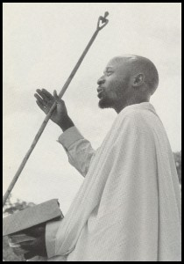
But frustration at the churches’ racism
African lay ministers and teachers critical to the church’s success in Africa as translators and workers.
African lay pastors not respected: less pay, less respect, denied promotion to senior ranks
Did the church speak to the dilemmas and needs of its congregants?
In the first decades of the twentieth century, a sudden burst of new churches created by African Christians

Slide 7
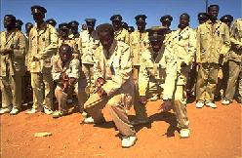
Zion Christian Church
Started in 1910 in Engenas Lekganyane who had a dream
Secession from another Black church
Is now the largest African-initiated church in South Africa
Centrally controlled; very hierarchical
Distinctive dress and language ( greeting: Khotso! Peace)
Both men and women can be prophets
ZCC dancing in uniform

Slide 8
The Africanization of Christianity
Music and dance in the service
Faith healing through the power of the Holy Spirit (also emphasized in American Pentecostalism): laying on of hands, holy water, drinking of blessed tea and coffee, exorcism of evil spirits
Divination and prophecy
And deals with the ubiquitous problem of witchcraft
Questions by Anthony Layne, Maddison Raively

Slide 9
Christianity becomes a resource to divine witchcraft and to protect against it
Prophet tells Madumo’s younger brother that their mother’s death caused by witchcraft, p. 15
Splashing of water and praying to prevent evil spirits from entering the church, p. 145
Diagnosis of troubles and cures/solutions provided, p. 168, pp. 171-172
“Don’t trust anyone,” p. 173ff
Treatment is free---although perhaps hidden expectations

Slide 10
And yet, some “modern” elements
Use of military-style uniforms and Western dress
Anti-traditional medicine: muthi and ZCC medicine don’t mix, p. 175-176
Are these elements “modern,” or “Western” or?

Slide 11
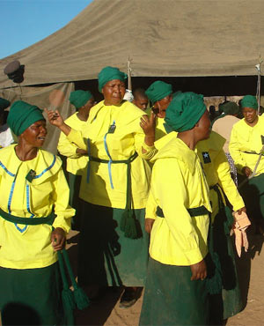
The Isidliso: The Inyanga-ZCC competition
Diagnosed by ZCC, p. 173
Question by Kelsey Schaffer
Not seen by Mr. Zondi, p. 179
Madumo overcomes his concerns about ZCC, p. 182
Mr. Zondi discredits ZCC: no isidliso, a natural sickness, reaction to the “strong” herbs, p. 186
But it could easily have gone the other way

Slide 12
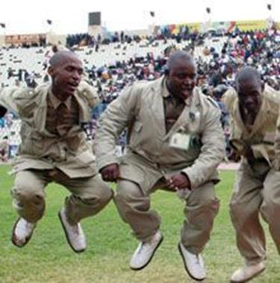
The Localization of Christianity: Some Conclusions
Happened over a long period of time
Through the actions of numerous people
The Bible was amenable to re-interpretation because Jesus dealt with evil spirits and healed people; perhaps contemporary mainline Western Christianity an aberration of the early tradition?
What “Western” or “modern” means has itself been Africanized

Slide 13
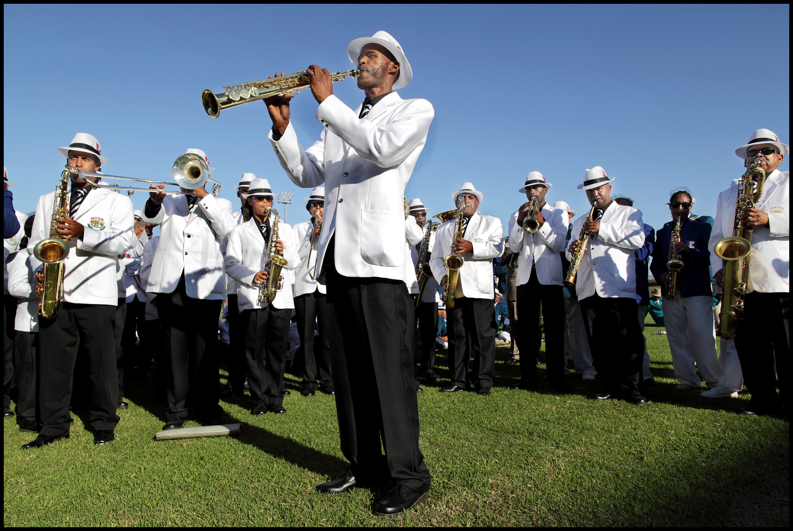
Notes:
Similar to Christmas Bands by Dr. Sylvia Bruinders?

