Slide 1
Assimilation to American Society
Theories and Realities

Slide 2
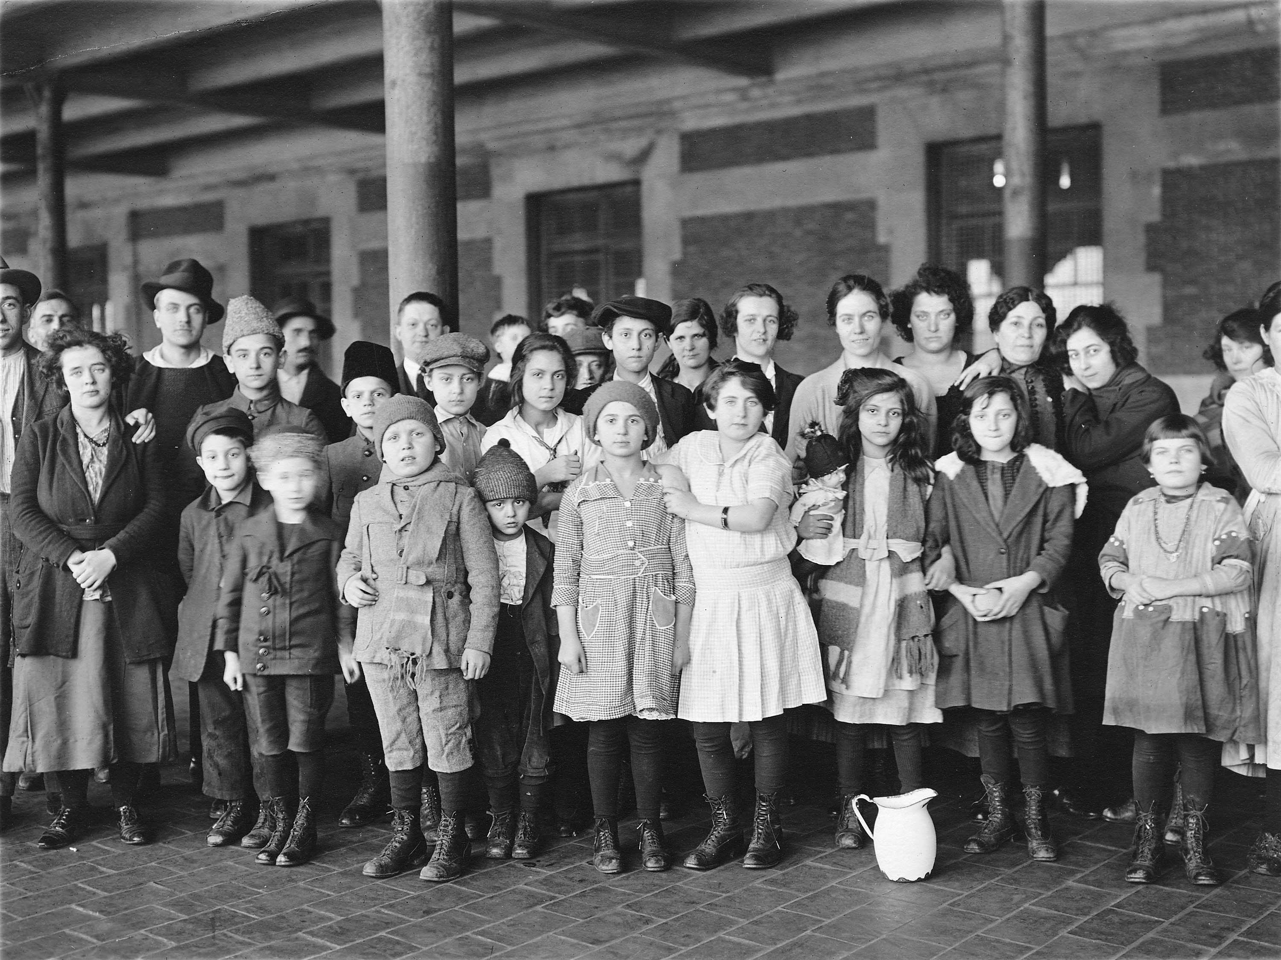
Assimilation/Americanization = Social Mobility
1st generation (immigrant generation) arrives without wealth, education, or fluency in English: works hard as an entrepreneur or in manual labor
2nd generation (children of immigrants): fluent in English, finish school in U.S., achieve middle-class status
3rd generation (grandchildren of immigrants): go to college, successful professionals
“Becoming American”: What does this mean?
Children at Ellis Island, 1908

Slide 3
In some measures of wellbeing and social mobility, immigrants do better than the native-born….
Education: lower high-school dropout rates for first generation immigrants than for second-generation immigrants or native-born; Stepick and Stepick, p. 133
Health: immigrants live longer, on average, than the native born, although the effect wears off the longer they live in the United States (or Canada)
Surprising!

Slide 4
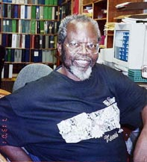
Cultural Ecology model by John Ogbu
Achievement in education is the result of the nature of the history, subordination, and exploitation of the minority group and the minority group’s interpretation and response to their oppression.
Autonomous minorities
Immigrant minorities
Subordinate or castelike minorities

Slide 5
How does the research by Stepick and Stepick complicate or make more nuanced Ogbu’s cultural ecology theory?

Slide 6
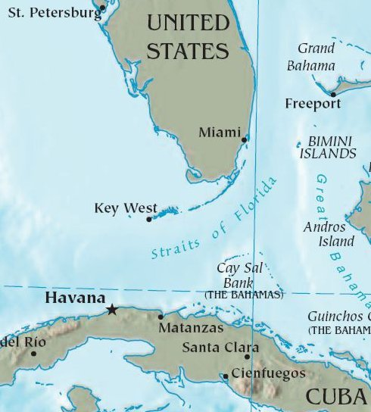
Miami: An Immigrant City
2.6 million people in Miami-Dade County
65% Hispanic or Latino; 51% foreign-born; 72% spoke language other than English at home
1.2 million Cubans in Greater Miami area; began migrating to Miami in 1950; Cuban Revolution 1953; came as refugees
Cubans are politically and economically prominent (first Latino president to be Cuban? Marco Rubio?)

