Slide 1
The State in Africa

Slide 2
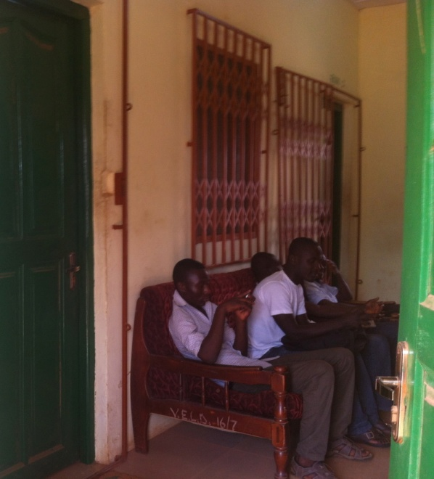
Why is the African State so…
Volatile?
Weak and fragile?
Corrupt?
Oppressive and/or indiffernt to its citizens?
Personalized—dependent on personal connections to get services, heated personalized rivalries between parties (rather than ideological differences)?

Slide 3
The rhizome state
The politics of the belly
Extraversion

Slide 4
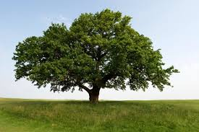
The African State is Rhizomatic (that is, made up of rhizomes)

Slide 5
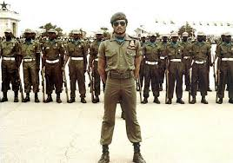
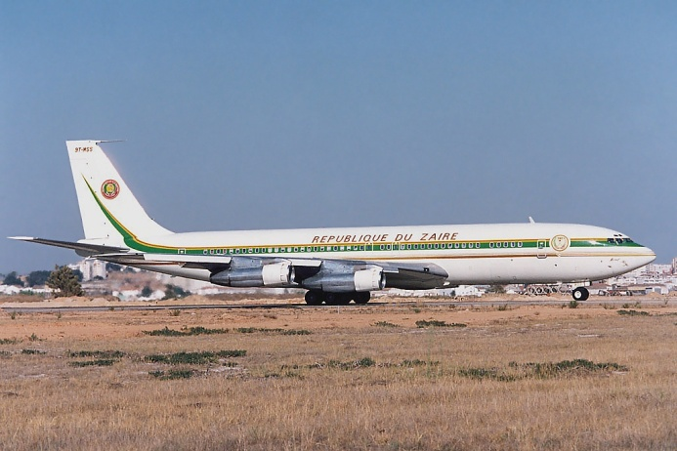
The Politics of the Belly
“I chop, you chop”
Politicians are like big men: their followers need to share in their prosperity; their prosperity is a sign of their political power (Rawlings)
Accusations of witchcraft
Inegalitarian and hierarchical
Why is there corruption? (Zairian air force)

Slide 6
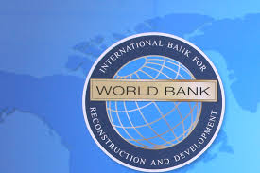
Extraversion of the African State
What does it mean for a person to be extraverted vs. introverted?
The African state is similarly oriented to the outside---as a source of power and resources
Some connections to pre-colonial ways that people obtain power; some connections to colonialism
More accountable to the World Bank, oil companies, etc than to its own populace

Slide 7
Democracy
What is it?

Slide 8
What did democratization mean in Mozambique?

Slide 9
What are the implications from Mozambique’s story for U.S. foreign policy in promoting democracy?

