Slide 1
Coffee:
Global Trade and Poverty Creation
Do you drink coffee?
How much do you spend
on coffee a day?

Slide 2
Global Trade stimulated by “Drug Foods”
Drug foods: little nutritious value, quick energy
Atlantic slave trade and sugar cane production
Tea from India and China
Coffee and chocolate
18th century Europe: these became everyday fare as working-class lost access to land (and therefore able to produce their own food)
Marshall Sahlins: “Certainly it involves some peculiar Western ideas of the person as an imperfect creature of need and desire, whose whole earthly existence can be reduced to the pursuit of bodily pleasure and the avoidance of pain” (1988, 43).

Slide 3
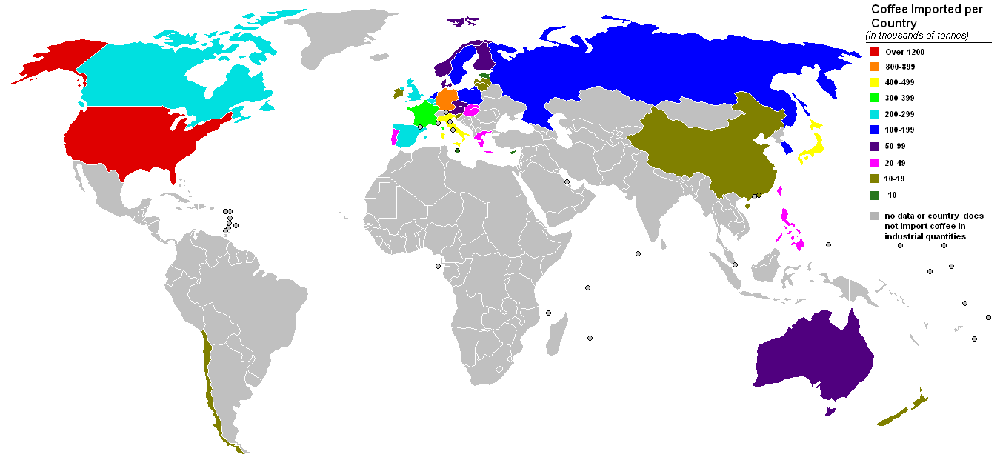
Who imports coffee:

Slide 4
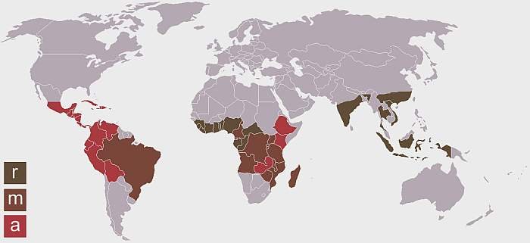
Who Grows Coffee: r = robusta, a = arabica, m = both

Slide 5
Why aren’t Africans rich from our importing coffee?

Slide 6
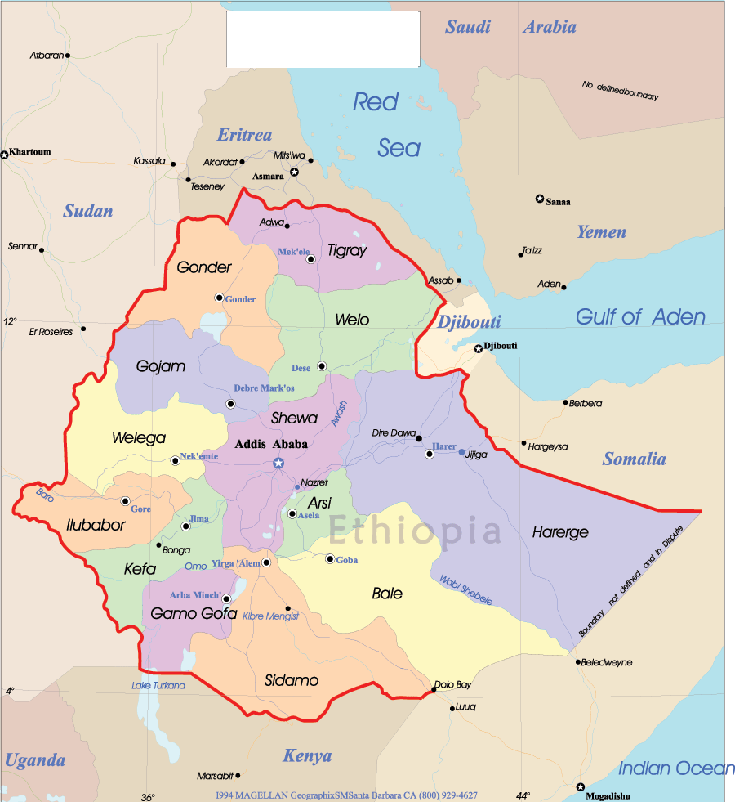
Ethiopia
Never colonized, but under Italian occupation during WW II
Slightly less than twice the size of Texas
Terrain is high plateau with central mountain range divided by the Great Rift Valley
82 million people
60% Christian, 33% Muslim
Military governments in 1970s and 1980s, but currently a democratically elected government
Exports: coffee, khat, gold, leather, animals, oilseeds
Currency: birr (8.96 birr = $1)
Debt: 44.5% of GDP (2007)

