Slide 1
Ethnic Festivals in the United States
What do they tell us about immigrant culture?
Are such festivals a route for holding onto their culture, assimilating, or creating something entirely new?

Slide 2
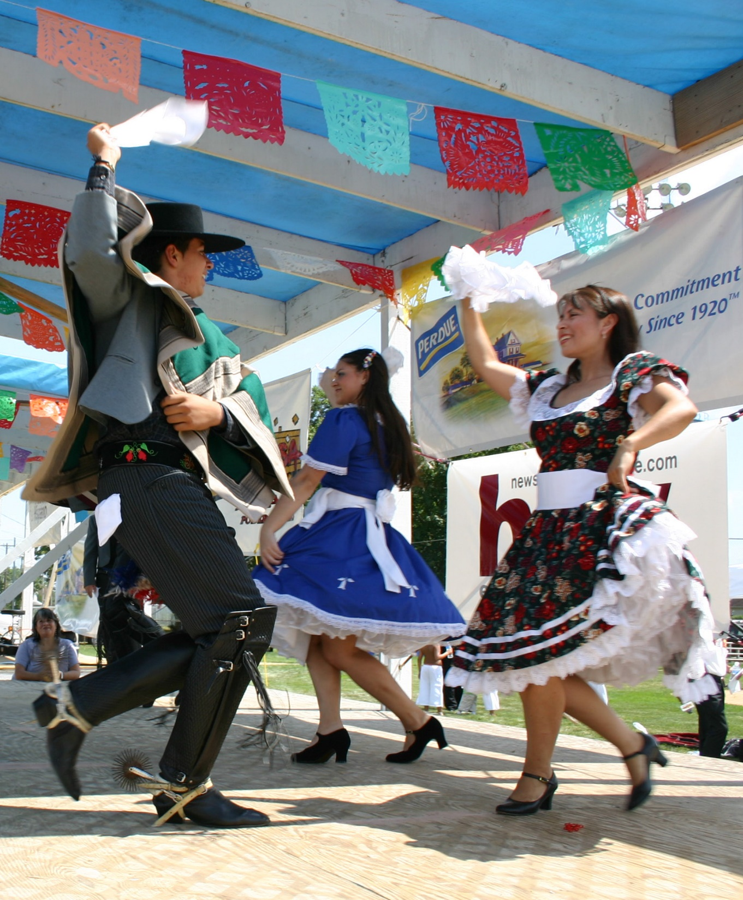
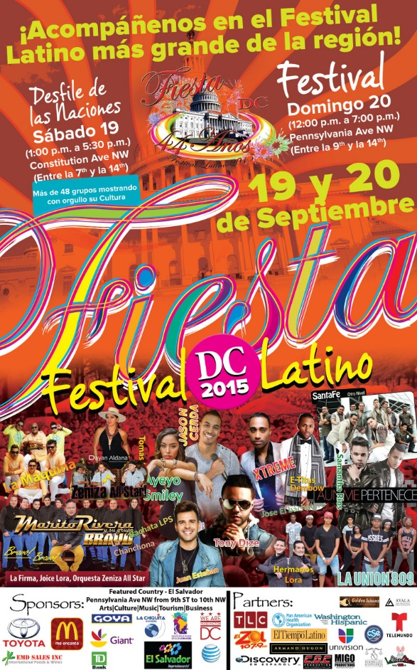

Slide 3
Jocelyn Gutierrez at the event in 2011 from Scripps Howard Foundation Wire http://www.shfwire.com/fiesta-dc-celebrates-latino-culture/
“Well basically,I came out with my family so that we could enjoy the festival and see the different Hispanic cultures that are out here,” Jocelyn Gutierrez, 17, a D.C. resident and senior at Luke C. Moore High School, said.
The parade of nations kicked off the festival with dancers from 30 folkloric groups from Latin America,Spain and the Caribbean.
“It showed everybody the different cultures that deal with Hispanic people, like we had the Bolivian, the Ecuadoran people, the El Salvadoran people,” Gutierrez said. “And it just kind of showed everybody what makes everybody distinct in their own way.”
Gutierrez said she enjoyed the different types of food and music and the different vibes everyone brought to the event.

Slide 4
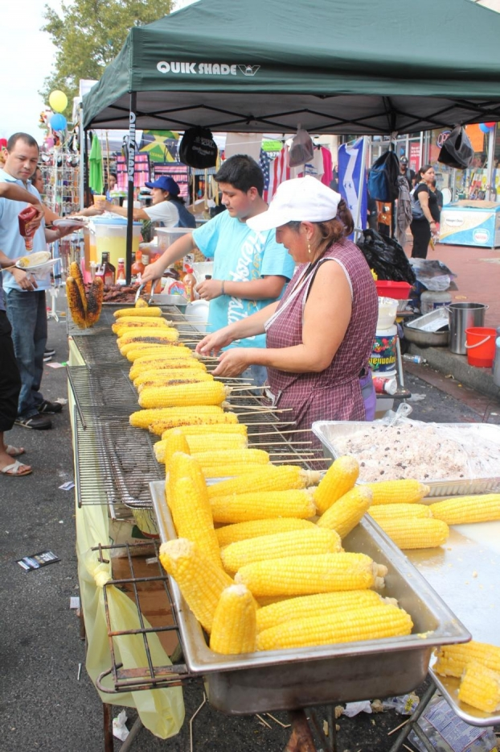
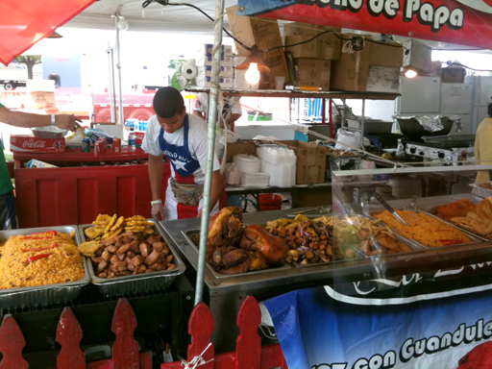

Slide 5
Discussion of “Making a Place Home: The Latino Festival”
How does the Latino festival make a place home?
Is this a continuation of an old culture, assimilation to an American culture, or creation of a new culture?
“Latino”
Private/public: does change happen as the private becomes public or does it allow for the immigrant kitchen to come into the street?
“the homogenizing tendency of tourist arts” p. 209
Different for different audiences?
Does “equal opportunity eating” and “egalitarian” tasting (p. 212) mean equal opportunity and equality in other areas?

Slide 6
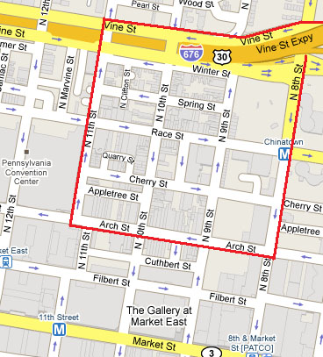
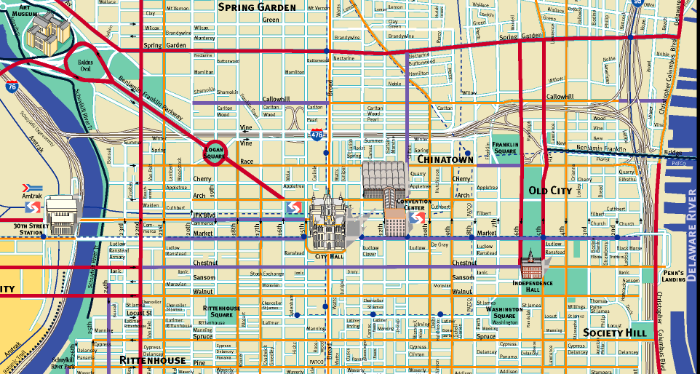

Slide 7
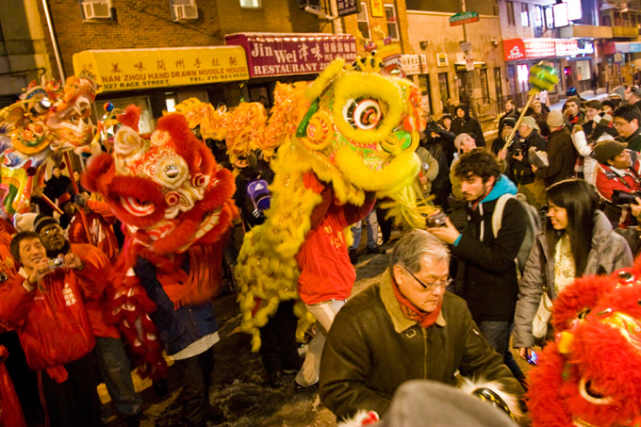
Chinese New Year will be in the beginning of February.

Slide 8
