Slide 1
Assimilation/Americanization = Social Mobility
1st generation (immigrant generation) arrives without wealth, education, or fluency in English: works hard as an entrepreneur or in manual labor
2nd generation (children of immigrants): fluent in English, finish school in U.S., achieve middle-class status
3rd generation (grandchildren of immigrants): go to college, successful professionals
Waters, p. 324: socially mobile white immigrants do not identify “ethnically”, 1930s
Children at Ellis Island, 1908

Slide 2
Immigration and English Language (as a kind of assimilation)
Immigration from Europe (pre-1965)
vs.
Immigration post-1965

Slide 3
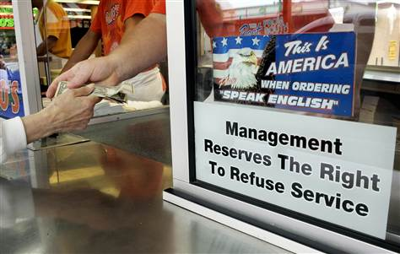
Geno’s Cheesesteaks, South Philadelphia, 2006

Slide 5
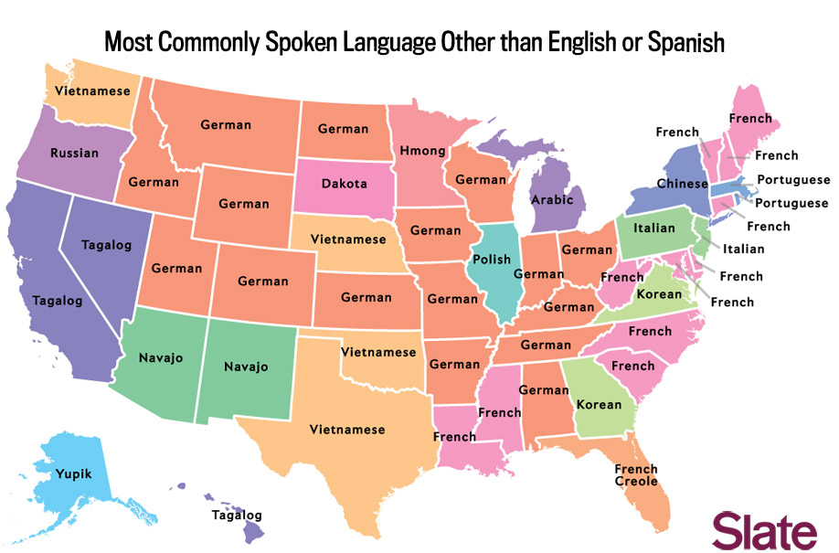

Slide 6
Why English?
And not a Native American language like Iroquois or Lenape/Delaware?
And not multilingualism (German, Vietnamese, Tagalog, Spanish, and English) ?
And not the language of the largest group?
A Creole in which languages are mixed together (like Haitian Kreyol)?

Slide 7
What argument do Portes and Schlauffer make about the language use and preferences of the children of immigrants?
What affects their language use and preference? Neighborhood? Social class? Racial identity? Length of stay?

Slide 8
Do you find their argument convincing? Or not?

Slide 9
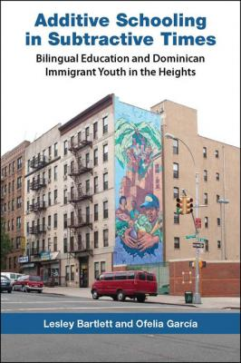

Slide 10
Adult Immigrants and English Language Use
Have you as an adult tried to learn another language? What was it like?
What kinds of work can people do in the United States without knowing English?

Slide 11
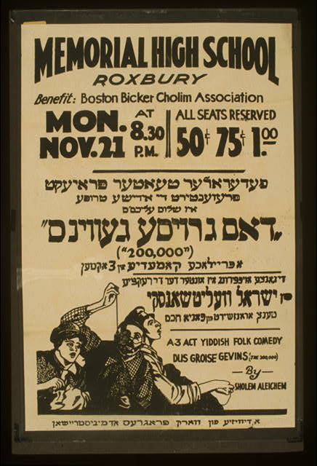

Slide 13
Both Waters and Portes & Schauffler are concerned with the effect of neighborhood on immigrant assimilation.
What are the implications of these studies for your second paper?
What conclusions might you be able to draw based on your observations and the arguments of these papers?

