Slide 1
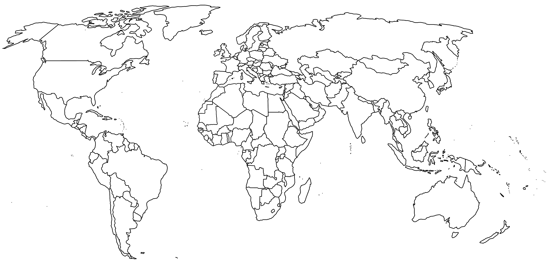
Central America: Nicaragua
Europe: Italy, Poland
North America: Mexico (2)
Southeast Asia: Philippines, Vietnam
West Africa: Liberia

